Slide 1
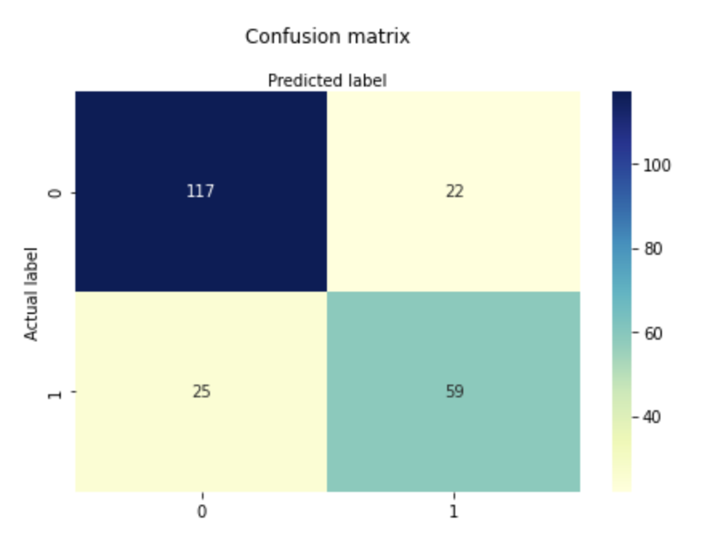
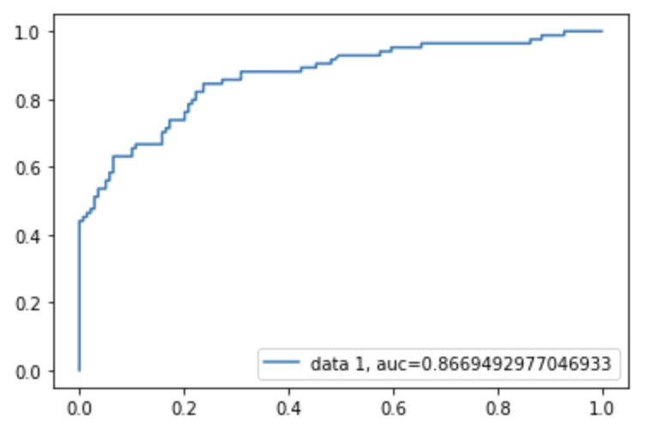
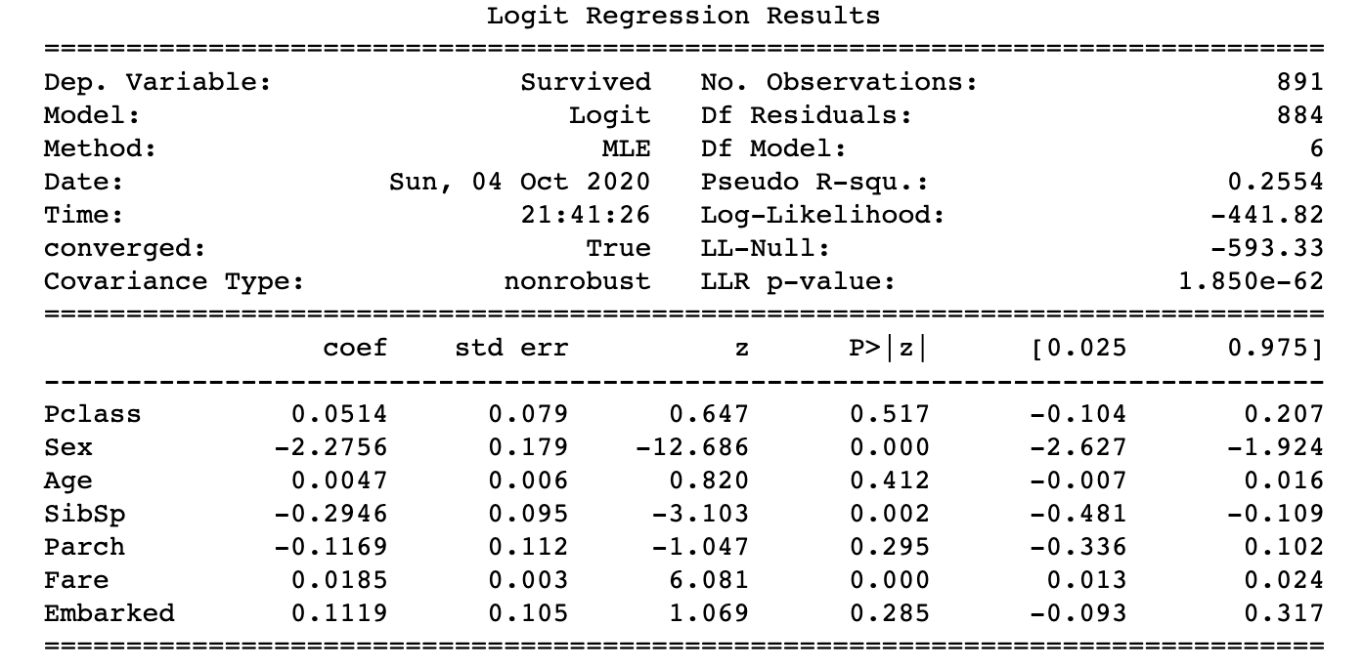
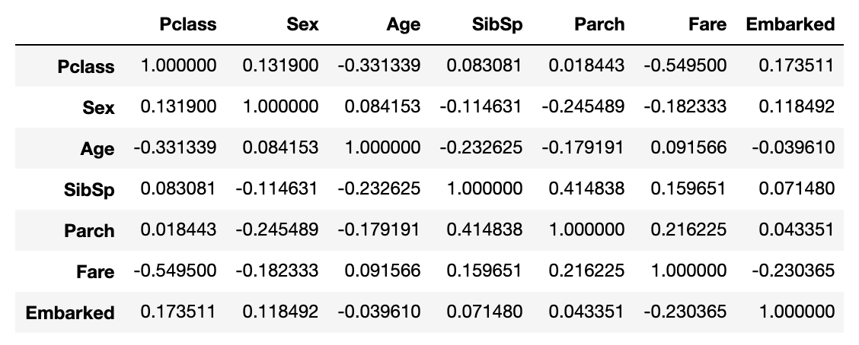
MATH 4995 Mini-Project 1: Logistic Regression Models on Titanic Survival Prediction
LIN Chi Wing cwlinaa@connect.ust.hk
1. Introduction
3. Choice of Model
Confusion Matrix and ROC Curve
This project is to give a predictive solution to the problem how likely of surviving on the Titanic given the attributes like age, gender etc. With the passenger data, a model will be built for general prediction for other passengers that whether they will survive or not. And hopefully some insights will be discovered, like what would determine the survival probability.
Methodology:
Logistic Regression
Reason:
Considered that the prediction output is of binary result instead of a continuous number, logistic regression is suitable and simple enough for the task.
Remarks:
Adding the L1 or L2 penalty to the model does not give a significant improvement to it as there are not much independent variables and most irrelevant variables are removed. So as PCA is not needed.
2. Cleaning the Titanic dataset
Steps:
Having a glance at the train.csv data and seeing if the data is making sense, e.g. Age is in normal range, and can put the assumption that all data are authenticate with no outliers
Remove the independent variable columns that is not predictive nor interpretable (Passenger Name, Passenger ID, Cabin and Ticket)
Replace the categorical data (Sex and Embarked) with numerical representation values, so that calculations can be implemented
Fill the NaN value, especially for Age column, with the mean value of the column, as there are many missing entries for Age. While there are not much missing values for the other columns, replacing them with mean value makes sense as well.
Visualizing pearson correlation of parameters:
4. Model Summary and Performance
6. Conclusion
The model summary shows that
female has a higher survival rate than male.
number of family members contributes negatively to survival rate
Position of embarkation is surprisingly significant attribute and positively related to survival rate
Model Performance:
The regression model has a quite high accuracy with fair precision and recall level. In addition, the AUC is satisfying that both positive and negative values are distinguished.
For the submitted kaggle file, it gained a score of 0.76555, which is satisfying as well as it has good prediction ability.
Accuracy: 0.7892376681614349
Precision: 0.7283950617283951
Recall: 0.7023809523809523

